Slide 1


M.Tech/MCA Program
Advanced Industry Integrated Programs
Jointly offered by University and LTIMindTree
A Multi-Agent Vision Framework for Automated PPE Compliance Monitoring
Review III
VISHWA M – 25MML0039
VIT-VELLORE

Slide 2
Multi-Agent PPE Compliance Monitoring
Introduction
PPE compliance is critical on construction and industrial sites
A complete event-driven multi-agent PPE monitoring system is built
It detects, assesses risk, finds causes, recommends and alerts
Memory and OSHA-based RAG ground the supervisor decisions
FastAPI and a Streamlit dashboard expose the results

Slide 3
Multi-Agent PPE Compliance Monitoring
Objective
Monitor PPE violations continuously and automatically
Give risk, root cause, recommendation and alert per violation
Maintain worker history and ground decisions in OSHA knowledge
Serve results through REST APIs and a live dashboard

Slide 4
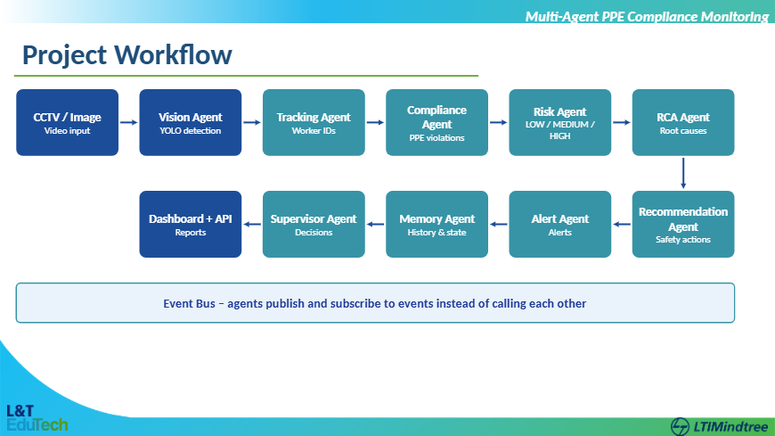

Slide 5
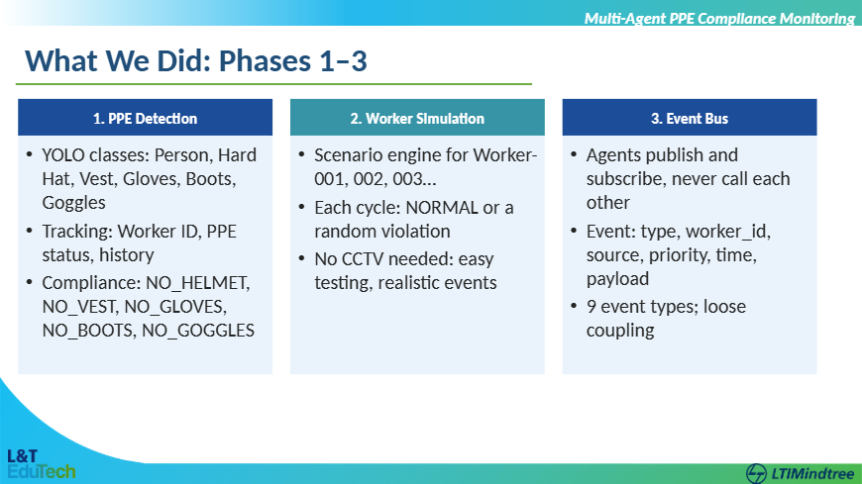

Slide 6
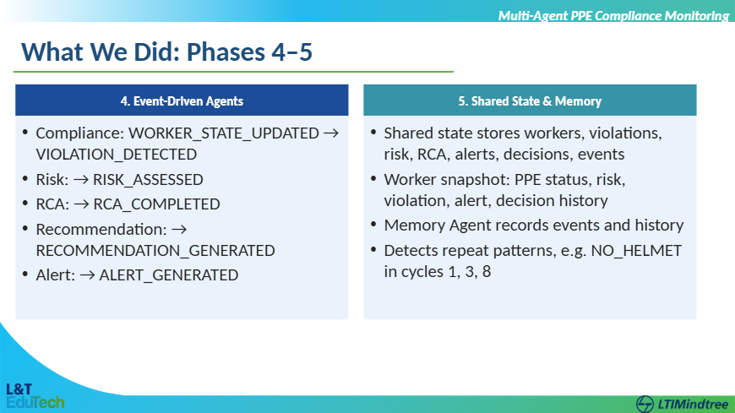

Slide 7
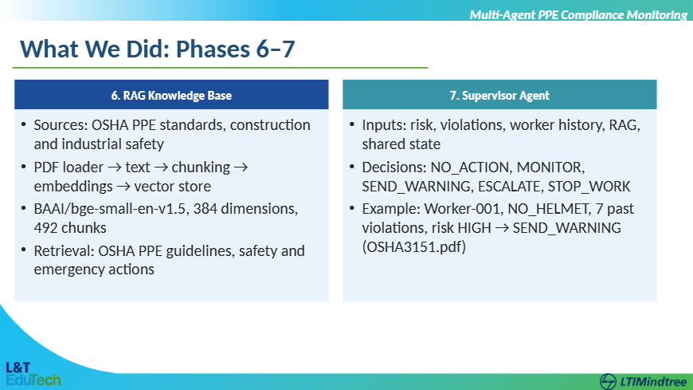

Slide 8
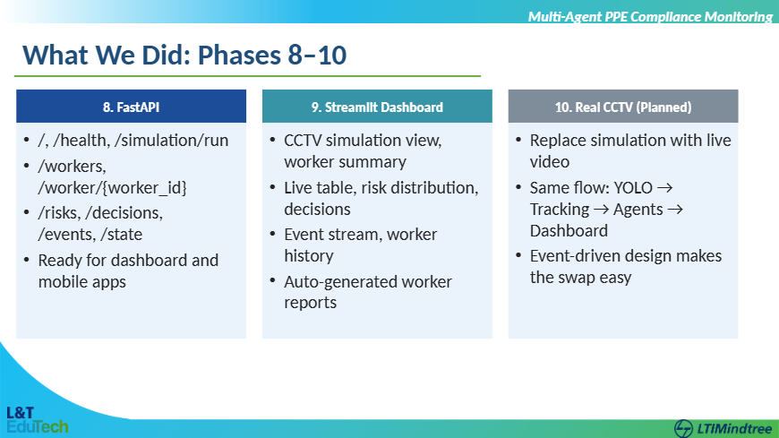

Slide 9
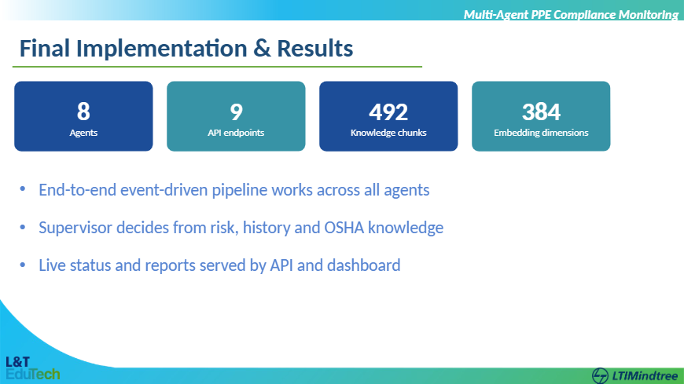

Slide 10
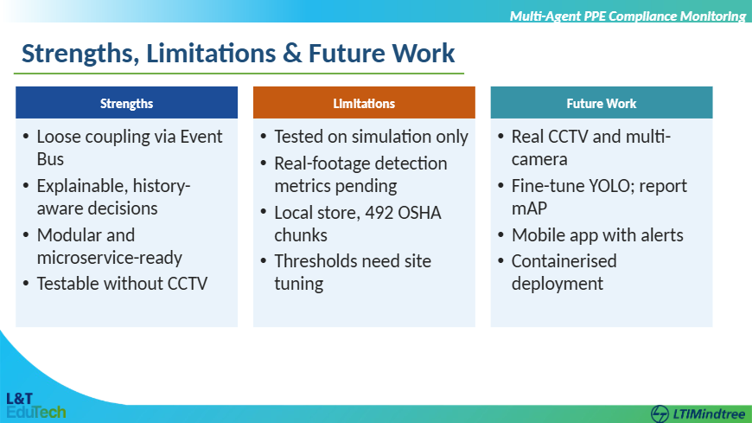

Slide 11
Multi-Agent PPE Compliance Monitoring
Conclusion
Delivered a complete event-driven multi-agent PPE system
Goes beyond detection to risk, cause, advice, alert and decision
Shared memory and OSHA RAG make decisions history-aware
FastAPI and Streamlit enable integration and monitoring
Future work: real CCTV, mobile app, microservice deployment

Slide 12
Multi-Agent PPE Compliance Monitoring
References
[1] Redmon et al., “You Only Look Once,” CVPR, 2016
[2] Lewis et al., “Retrieval-Augmented Generation for Knowledge-Intensive NLP Tasks,” NeurIPS, 2020
[3] Wojke et al., “Simple Online and Realtime Tracking with a Deep Association Metric,” ICIP, 2017
[4] Xiao et al., “C-Pack: Packaged Resources to Advance General Chinese Embedding,” 2023
[5] Wooldridge & Jennings, “Intelligent Agents: Theory and Practice,” 1995
[6] OSHA, “Personal Protective Equipment,” OSHA 3151

